Slide 1


THEMIS
answer to streamline client’s portfolio
[ˈθɛmɪs]
Themis: The Greek Titan Goddess of Divine Law and Order

Slide 2







Themis has already helped many clients, who valued the tool as fundamental for solving some of their needs
CLIENT NEEDS
1
2
3
Identify new business initiatives with the highest market potential
Rank initiatives aligned with business priorities and strategic objectives
Optimize the current initiative portfolio
Clients who showed strong interest in the tool

Slide 3
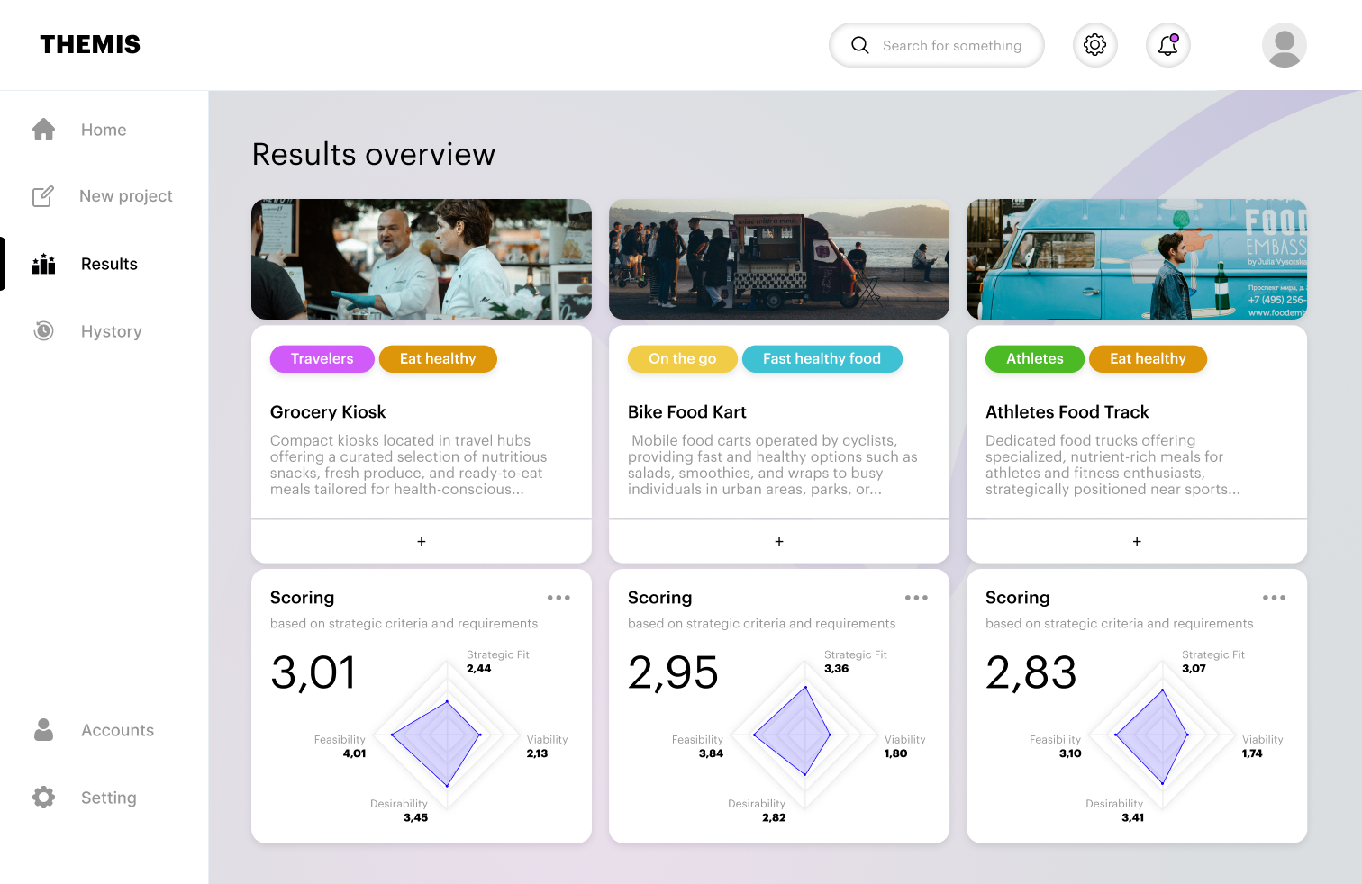
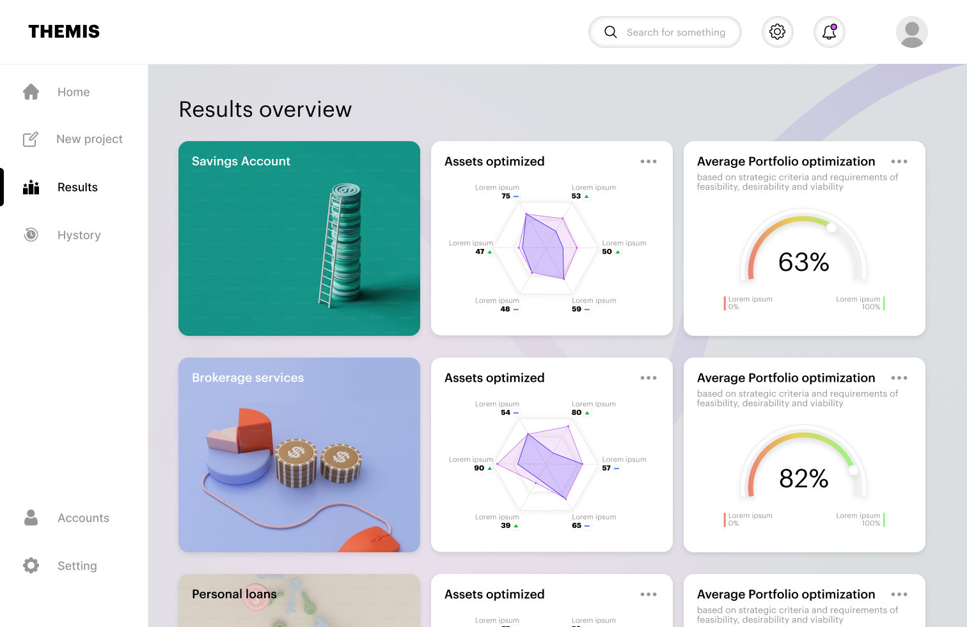
Themis evaluates and prioritizes new and existing initiatives, selecting the best performers to optimize impact
THEMIS
Prioritization and selection of the most promising initiatives based on the client’s strategic objectives
Optimization of the initiative portfolio based on client’s strategy and the initiatives’ performances
GenAI-enhanced experience

Slide 4
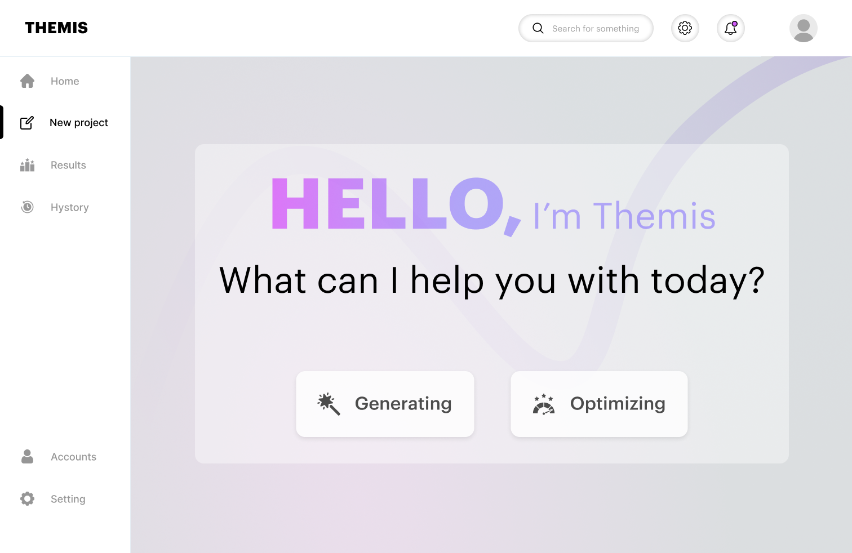
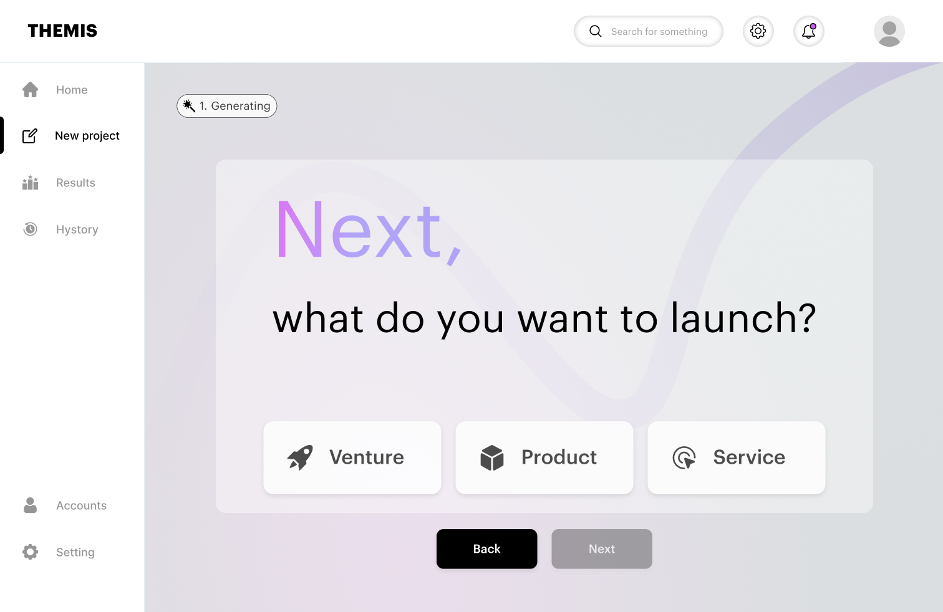
What Themis can do for you
Themis can be used by different companies' departments (R&D, products, innovation & marketing) thanks to its adaptability and simple UX. Starting with two simple questions, Themis guides through a series of prompts to the final initiative generation.
What do you want to do?
What do you want to launch?

Slide 5
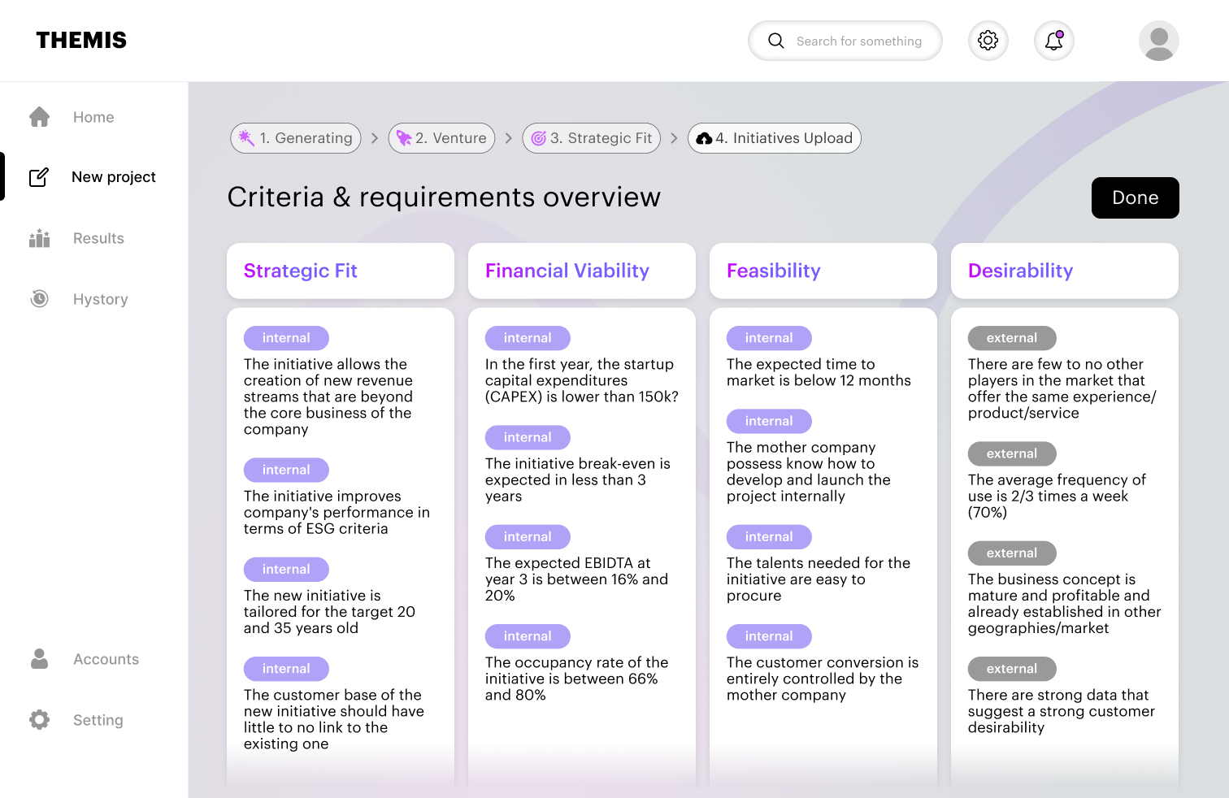
A guided strategic fit to meet market and client needs
The first step is to define the strategic objectives of the company. Themis gives suggestions about the main business criteria & requirements that will guide the generation and selection of the best initiatives.
The criteria and requirements are defined by the client (internal) and by market research and analysis (external).
What do you need to consider?

Slide 6
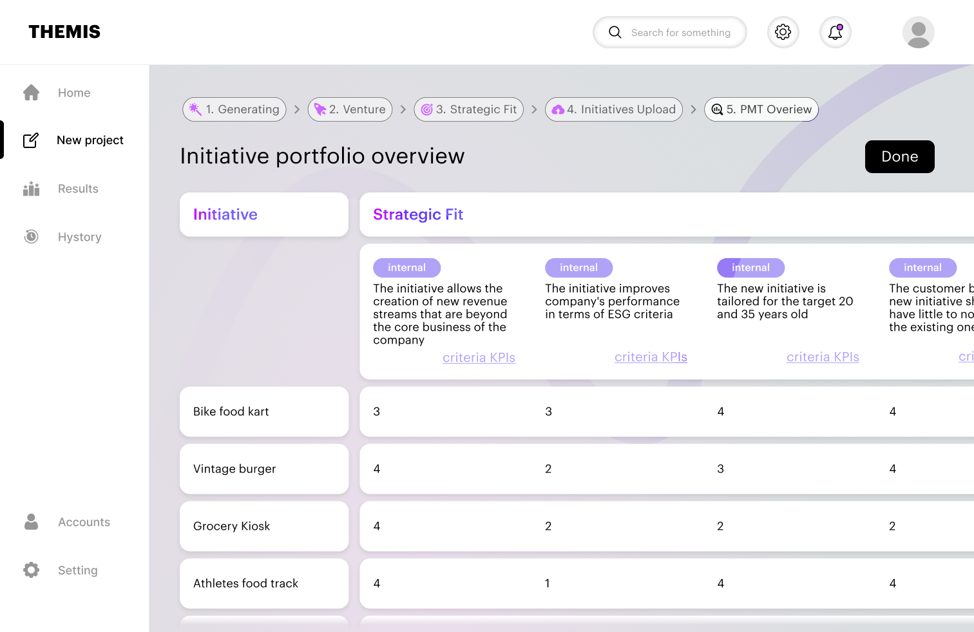
Augment and evaluate your initial input
Once the initiatives are inserted in the tool, Themis assesses them and retains those that meet all the selected requirements. The user will then assign a score per criteria from 1 to 5 to each of the selected initiatives.
What’s the impact of each initiative?

Slide 7
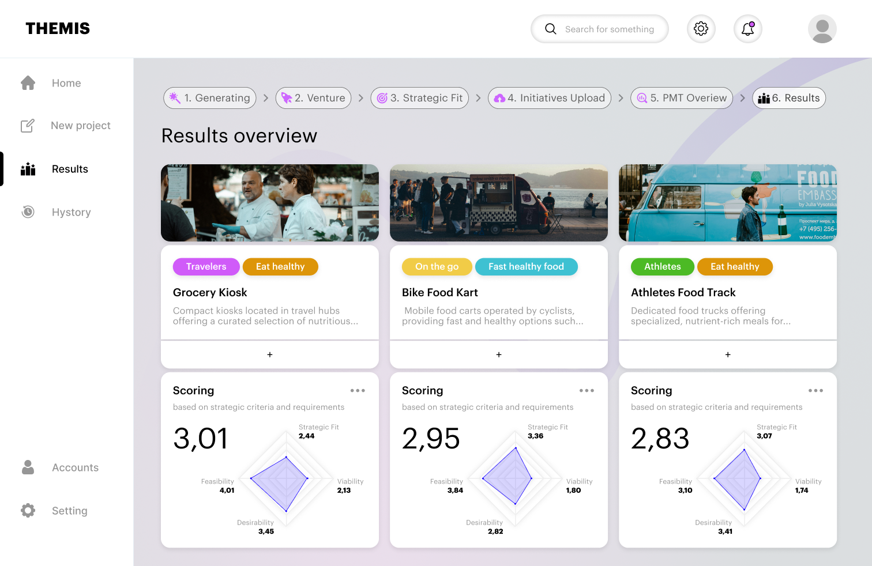
Automatic ranking of the most promising initiative
At the end of the funnel, Themis ranks the most promising initiatives based on the requirements and criteria previously defined. It also generates a comprehensive description of the concept with a visual inspiration.
Here are the results
Possible integration with other external GenAI powered tools (by Accenture) to expand and deepen the concept generation

Slide 8
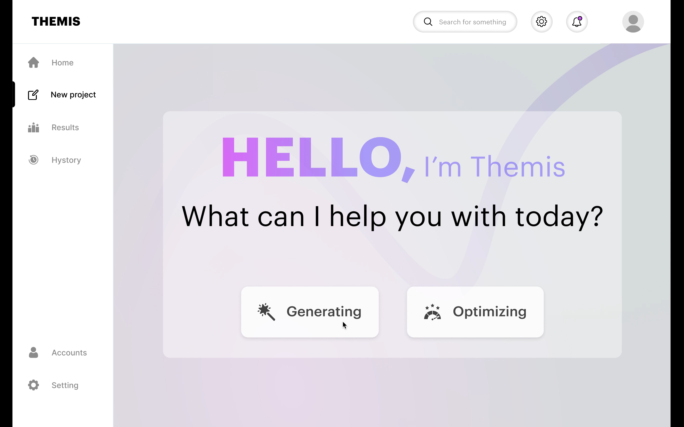

Slide 9
Project timeline – high level hypothesis
Month 1
Month 2
Month 3
Month 4
Month 5
Month 6
Month 7
Month 8
Month 9
Month 10
Month 11
Month 12
Tool discovery
Design
Alpha Development
Beta Development
Testing
Pre-Launch
Project set up
Technology stack decision
UX/UI design
Architecture design
Prototype development (MVP)
Alpha internal testing
Iteration & refinements
Unit and user acceptance testing (Beta)
Launch preparation
Final refinements
GTM strategy
Alpha release
Beta release
First users

Slide 10



Budget & team for the project set up
Team composition
Estimated Budget
Luca Badessi
10.000€
Venture Building Manager
Sofia Motta
Deliverables [TBC]
Venture Building Consultant
Identification of the development team
Estimation of the development costs
In-depth project roadmap
High-level user journey
Return on investment
High-level P&L
Alice Sozzi
Venture Building Intern

Slide 11
THANK YOU

